Slide 1
Data Communications

Slide 2
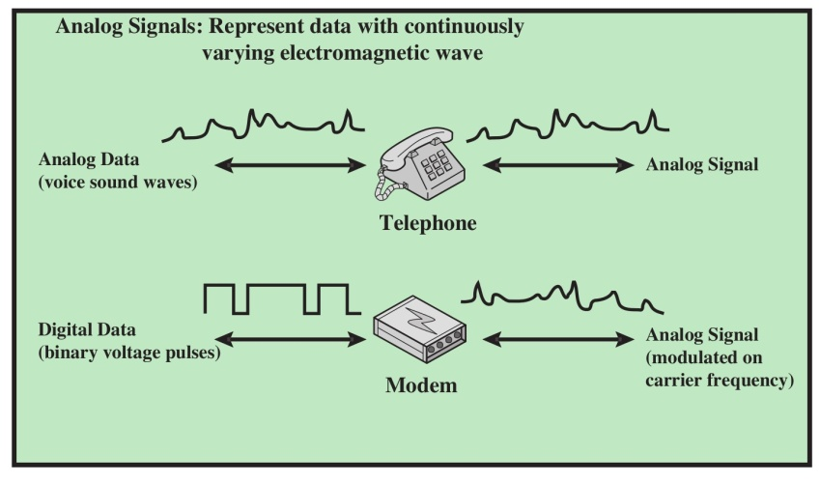
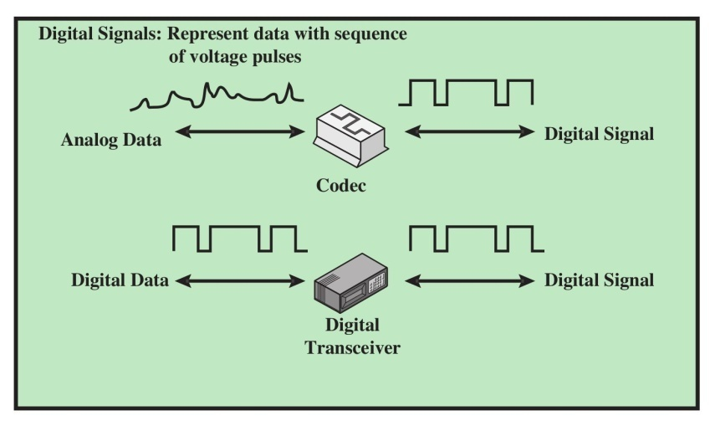
Analog Signaling of Analog and Digital Data
Digital Signaling of Analog and Digital Data
.

Slide 3
Line Coding
The process for converting digital data into digital signal.
.

Slide 4
Line Coding
There are three types of line coding schemes available:
.

Slide 5
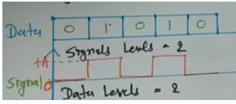
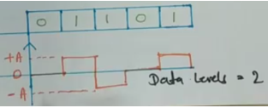
Signal level and Data level
signal level : Number of values allowed in a particular signal. (voltage level)
Data level : Number of values to represent data. For binary two values 0 and 1.
.

Slide 6
Pulse rate and bit rate
Pulse rate : number of pulses per second.
Bit rate : number of bits per second.
If one pulse corresponds to one bit then pulse rate equal to bit rate.
If the pulse carries more than 1 bit, then pulse rate is lower than bit rate.
bit rate = pulse rate X log₂ L
.

Slide 7
Self synchronization
There is enough timing information in the transmitted data that keep the sender and receiver synchronized.
.

Slide 8
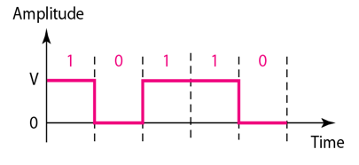
Uni Polar
All the signal levels are on one side of the time axis, either above or below.
1 - high voltage is transmitted
0 - no voltage is transmitted.
.

Slide 9
Polar
In polar schemes, the voltages are on both sides of the time axis.
Polar encodings are available in four types:
Polar-NRZ ( Non Return to Zero)
Polar-RZ (Return to Zero)
Manchester
Differential Manchester.
.

Slide 10
BiPolar
Bipolar encoding uses three levels.
ie positive, zero and negative.
Zero level represent binary ‘0’ and alternating positive and negative voltage represents binary ‘1’.
.

Slide 11
POLAR-NRZ (NON-RETURN TO ZERO)
It uses 2 different voltage levels – one positive and other is negative.
Voltage level is constant during bit interval.
NRZ scheme has two variants:
NRZ- L
NRZ - I
.

Slide 12
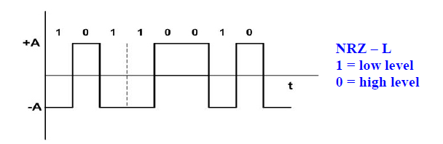
NRZ-L
NRZ-L changes voltage level at when a different bit is encountered
.

Slide 13
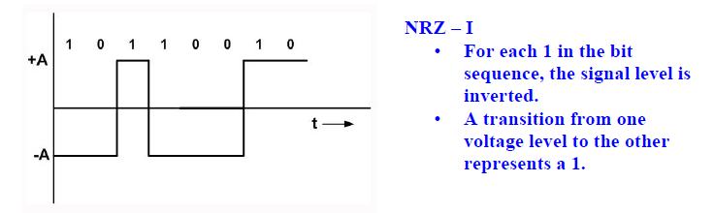
NRZ - I
NRZ-I changes voltage when a 1 is encountered.
.

Slide 14
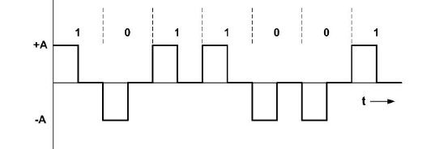
POLAR-RZ (RETURN TO ZERO)
Synchronization is the major concern in previous techniques (NRZ)
To overcome that we can use RZ encoding
Here to ensure synchronization, there must be signal transition in each bit
.

Slide 15
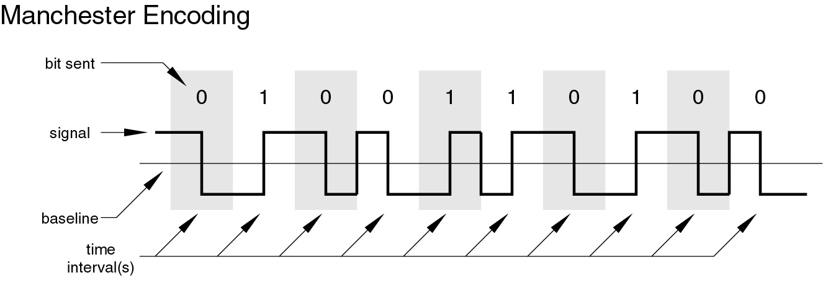
MANCHESTER (Biphase) ENCODING
there is a transition at the middle of each bit period.
The mid bit transition serves as a clocking mechanism and also as data:
a low-to-high transition represents a 1,
a high-to-low transition represents a 0.
.

Slide 16
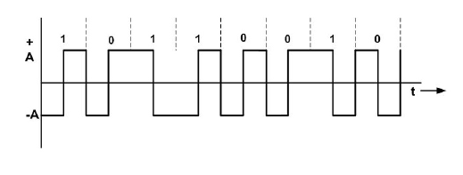
DIFFERENTIAL MANCHESTER ENCODING
There is always a transition at the middle of the bit, but the bit values are determined at the beginning of the bit.
If the next bit is 0, there is a transition.
If the next bit is 1, there is none.
.

Slide 17
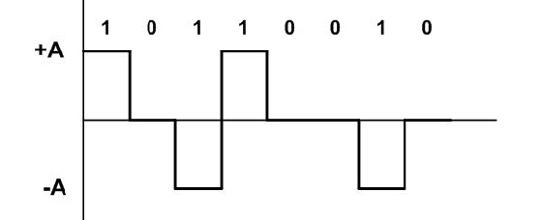
Bipolar
Bipolar AMI (Amplitude Mark Inversion)
Bipolar AMI uses 3 voltage levels.
The zero level is used to represent 0.
Binary 1’s are represented by alternating positive and negative voltage.
Loss of synchronization for long sequence of 0’s
.

Slide 18
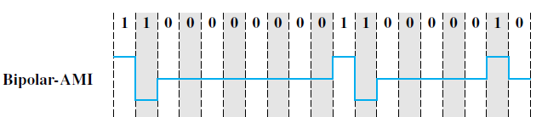
Bipolar
Bipolar AMI (Amplitude Mark Inversion)
.

Slide 19
Bipolar
Pseudoternary
Same as AMI, but alternating positive and negative pulses occur for 0 instead of 1.
.

Slide 20
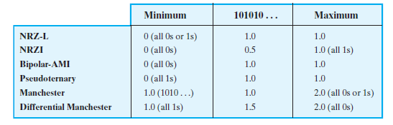
Table 5.3 Normalized Signal Transition Rate of Various Digital Signal Encoding Schemes
.

